Slide 1

Indonesia's epidemic situation:
HIV is not yet over - we need to intensify our efforts to reach most at risk key population
Dr. Wiendra Waworuntu, M.Kes
Director, Communicable Diseases, Indonesia Ministry of Health
Presented at:
Satellite session on “Breaking Barriers toward sustainability of
AIDS response in Indonesia”
Amsterdam, 23 July 2018
Notes:
Thank you. I will present Indonesia’s epidemic situation on HIV as well as the progress and challenges in HIV response in the country.

Slide 2
OUTLINE
Epidemic Situation
Programme Achievement
Priority Districts and Strategy
Challenges
The Way Forward
Notes:
This is the outline of my presentation today.

Slide 3
Epidemic Situation
Notes:
Ok, we start with the epidemic situation…

Slide 4
Drivers of HIV epidemic in Indonesia
1987
Start of the epidemic in Indonesia
Gay men (MSM)
Late 1990s-2007
HIV peaks among…
Injecting Drug Users
2008 - now
Main transmission driven by…
Heterosexual
Notes:
First, we need to know the drivers of HIV epidemic in Indonesia.
Indonesia’s first case of AIDS was reported in 1987, and the earliest cases were occur among MSM
Then, the epidemic was driven by injecting drug users (IDUs) group. The peak among IDUs was in 2007, the prevalence was at 52% at that time.
After that, it’s driven by heterosexual group that includes sex workers and husband-to-wife transmission.

Slide 5
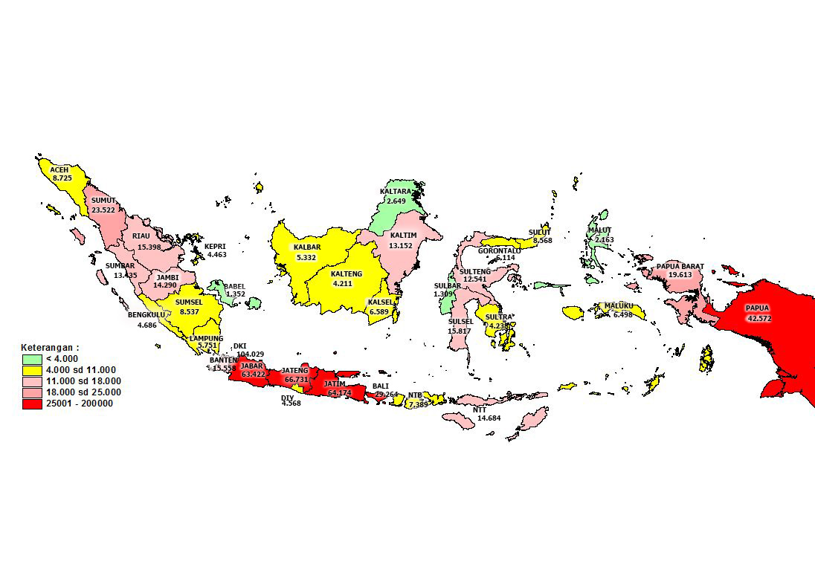
Estimated PLHIV in Indonesia by Province
In 2017, there were 631.000 estimated PLHIV
Notes:
Indonesia remains a highly concentrated epidemic among key populations, except for two provinces in Tanah Papua with HIV prevalence of 2.3%.
In 2017, there were 631 thousand estimated PLHIV in Indonesia. The map shows the distribution by province. The highest estimated PLHIV is in DKI Jakarta, with estimated 104 thousand PLHIV. Overall, most PLHIV can be found in Papua and the provinces in Java island (the red one).

Slide 6
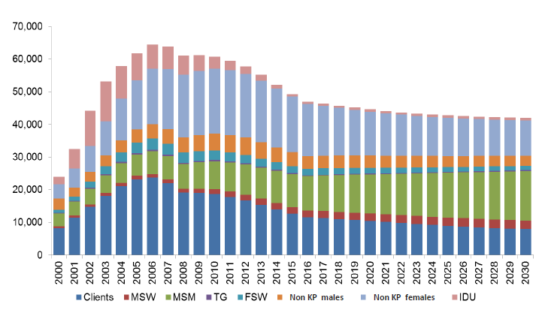



Epidemic in Numbers
In 2017, there were…
49.000
new HIV infections
Estimated new HIV infections by sub-population, 2000-2030
39.000
AIDS-related deaths
Notes:
With 49 thousand new infections per year, the total number of PLHIV is constantly rising. The number of AIDS-related deaths is still high as well, around 39,000 deaths per year.
In the right side, you see the estimated new HIV infections by sub-population. The modelling indicates that Indonesia is not yet on course to end HIV and AIDS by 2030, since new HIV infections will remain at the same level.

Slide 7
Programme Achievement
Notes:
Next, I will show you the programme achievement in response to HIV, particularly on HIV testing and treatment.

Slide 8
Number of people tested for HIV, diagnosed and on ART
2012 vs 2017
14% treatment coverage
Notes:
In the past 5 years, there is significant increase of HIV testing conducted from only 300 thousand to more than 2.5 million tests.
As of December last year, 44% of the estimated total PLHIV know their HIV status.
Some success was achieved in increasing the number of persons on ART, reaching more than 91 thousand. But the treatment coverage is still low at 14%.

Slide 9
Case Finding among Key Population, 2015-2017
FSW
MSM
TG
PWID
Notes:
Despite the enormous expansion of HIV testing services, an estimated 56% of PLHIV remain undiagnosed.
The trend shows an increase of HIV testing and HIV+ among all the 4 groups of key population.
To enhance the efficiency of HTS, new approaches are needed. I think in session 2, the speakers will talk more about the innovations to fast tracking the HIV response.

Slide 10
Priority Districts and Strategy
Notes:
Let’s see the planning on priority districts and strategy that has been set by the Ministry of Health

Slide 11
District-based Intervention Plan
276 “Basic” Districts
(19 % KAPs, 21% PLHIV)
142 “Medium” Districts
(24% KAPs, 23% PLHIV)
96 “Complete” Districts
(57% KAPs, 56% PLHIV)
Notes:
To plan and implement the National AIDS Program, all districts in Indonesia are classified into categories based on disease burden and readiness and commitment from local government.
These are the 3 categories:
Complete districts: Districts where there is the highest number of KAP and PLHIV will receive complete intervention package.
Medium districts: Districts which are not included in category 1 but still have significant number of KAP and PLHIV, will receive medium intervention package.
Basic districts: Districts with least number of KAP and PLHIV will receive basic intervention package.

Slide 12
Fast Track target – PLHIV on ART
Notes:
For the target of PLHIV on ART, we also use the same district-based categories.
The green line here is the target for Complete districts, the yellow line is for Medium districts and the red line is for Basic districts.
A higher target is set for Complete districts, because the majority of PLHIV live there.
Nationally, 84% of PLHIV are targeted to be treated by 2027.

Slide 13
Fast Track strategy
Suluh-Temukan-Obati-Pertahankan (STOP)
Educate-Test-Treat-Retain
S – T O P
Suluh / Educate
Temukan / Test
Obati / Treat
Pertahankan / Retain
Health education/
promotion
Community participation
Health cadre
New outreach models
CBS study
Partner notif; HIV testing among other group
Treat all
Simplification in ART initiation
ARV price reduction
Expand services
Patient support group
Specimen transport for VL
Reminder to take the ARV
Notes:
Our strategy to achieve the fast track targets is called STOP, which stands for Suluh, Temukan, Obati, Pertahankan in Bahasa Indonesia - or Educate, Test, Treat, Retain in English.
The continuum of care for PLHIV extends from HIV testing through enrolment in HIV care, ART initiation and retention in life-long ART and chronic care.
We realized that to ensure the continuum of care, we must add a step for Educate.
Under ‘educate’ we need to improve:
Health education
Community participation
Health cadres role
Under ‘Test’ are innovative strategies such as:
New outreach models. (For example: using internet-based outreach for FSW or MSM)
Community-based screening
Partner notification: a voluntary process where trained health workers offer HIV testing to partners with their consent. We have trained the health workers at provincial level to do partner notification.
Under ‘test’ we are also trying to get more people at risk to be tested or HIC, such as mining workers, migrant workers, orphans and others.
The next is ‘treat’ and these are some strategies
Treat all
Simplification in ART initiation (pre-ART lab test to be conducted after ART initiation)
ARV price reduction
Expand services, especially in Complete districts to all primary health cares and public hospitals.
And the last is ‘retain’ that includes:
Patient support group: (it would be great if the patient could be supported by their family, the closest people to them, including to remind the patient to take the medicines (ARV).)
Specimen transport for VL: (this aims to expand the number of PLHIV who are tested for viral load so that we have information how many of them are virally suppressed as this the third-90 target.)
Reminder to take the ARV: (using Information Technology such as SMS reminder, mobile apps etc.)

Slide 14
Challenges and the Way Forward
Notes:
Now I want to talk about the challenges and the way forward.

Slide 15
Challenges
Dismissal of the National AIDS Commission
Stigma and discrimination
Financing for a sustainable response
Notes:
First, the National AIDS Commission (NAC) was dismissed the end of last year. This arrangement has left HIV response, particularly on HIV Prevention programme, under threat as in the past NAC was responsible for the procurement of Prevention commodities such as condoms, lubricants and needles. This has not yet fully integrated into the GoI system.
Stigma and discrimination remains the top challenge for people seeking services. We have build capacity for key population groups to understand their rights to health and provide them community-friendly access to services, but it still needs to be a concern.
Finally, international funds for HIV programmes in Indonesia are decreasing. Working to bring down the cost of medicines and other commodities is one way to do this. I’m sure pak Pungkas will explain more about the sustainability of HIV programme.

Slide 16
The Way Forward…
Ensure that each cities/districts implement Minimum Service Standard (MSS / SPM)
Strengthen collaboration with other programme: TB/HIV and PMTCT
Notes:
There are some things that Indonesia can do to fast-tracking HIV response and eventually end AIDS by 2030:
Ensure that each cities/districts implement Minimum Service Standard (MSS / SPM). With the Minimum Service Standard, each city/district is responsible to provide funding allocations for HIV.
Strengthen TB/HIV collaboration
As for PMTCT, Indonesia aims for HIV infection, syphilis, and hepatitis B elimination in 2022. NAP and the directorate of Family Health under the MoH has been collaborating to increase the coverage of HIV testing in antenatal care and promote spouse/partner testing when a pregnant woman is HIV positive.
On TB/HIV:
Currently, the Ministry of Health has implemented a lot of efforts to improve TB-HIV service. Our current investment is strong enough to start and accelerate the coverage:
1. Relevant policies and regulations are available.
2. Government commitment to provide the required logistics is high. The provision of drugs, tests, reagent should not be a problem anymore.
3. There are examples of good practice in the districts with good achievement of TB-HIV control targets. The practice is realistic, feasible, and scalable in other districts.

Slide 17
THANK YOU
Notes:
That’s the end of my presentation. Thank you for your attention.

